Slide 1
King resort analysis

Slide 2
Problem Identification
Recently king resort has invested on additional chairs in their resorts which has increased their operational cost with $1.5M.
Resort’s yearly profit margin is 9.2%.
Resort want to retain the profit margin of 9.2% annually by considering the additional operating cost of $1.54M
Our target is to analyze the data of their 330 ski resorts provided by king resort and provide the recommendations .

Slide 3
Problem Identification Cont..
As only the operational data is available for analysis and no the financial data, we would be providing recommendations only to optimize operations.
The impact of the recommendations on revenue would be uncertain.

Slide 4
Key findings and recommendations
It was observed that The Adult Weekend ticket prices are highly impacted by number of runs in the resorts.
Higher the runs more the ticket cost.
It is also observed that the older resorts have higher footfall and number of runs. We can conclude that older resorts are well established and company need to focus more on establishing newer resorts.

Slide 5
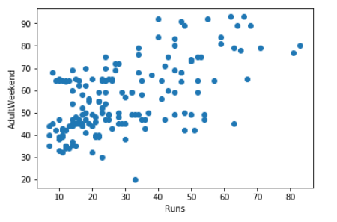
Modeling results and analysis
- During the analysis of King Resort’s data, the inter correlation of many features was analyzed.
- In this chart w can clearly see that the co-relation between number of runs and the Adult weekend price of resorts.
-As the number of run increase the weekend price also increases So it is suggested to increase the number of runs where ever possible to yield the higher profit.
- In some resorts the Adult weekend price is low even after having the higher number of runs. Those should be increased to appropriate level gradually.

Slide 6
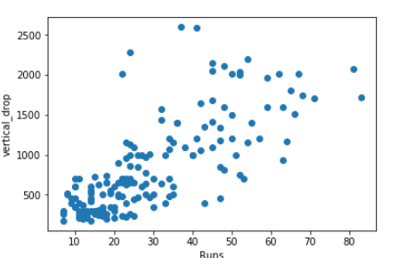
-In this figure we can visualize the co-relation between number or runs and vertical drop of the resort.
- The resort with higher number of runs has higher vertical drop.
- It has been suggested to increase the vertical drop where ever possible to increase the number of runs
- There are some anomalies in the chart as well, which represents the low number of runs in spite of having the higher vertical drop. Those resort should increase the number of runs to generate higher profit.
- It is recommended to have a levels of price depending upon the number of runs and vertical drop of the resort.

Slide 7
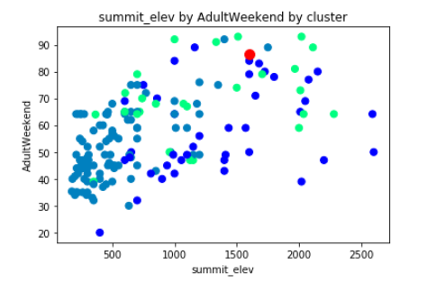
Predicting Model
- We have used the linear regression model for the prediction of Adult_weekend prices.
- By the available data our prediction model has the accuracy of 63%
- The model has rightly predicted the data point which was tested on it with less then 1 % of error.
Vertical_drop
- In the provided figure, the predicted data has been compared with the vertical drop of the resorts. The predicted value is about the same range with the original value

Slide 8
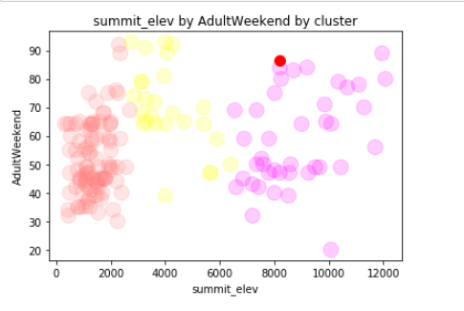
- In this figure the predicted and original value of adult weekend has been plotted with comparison of summit elevation of the resorts.
- We can see it clearly that the predicted value is in same range as the original value.
- This bubble plot also shows the 3 different cluster of the misprision where the entire result have been divided . We can interpret these as 3 different categories of height of elevation

Slide 9
Conclusion
King resort would be able to retain the net profit even after investing on the new chairs.
We need to increase the prices of tickets based on the recommendations.
Many resorts should be streamlined with the price range of tickets to yield the maximum profit.

